Slide 1
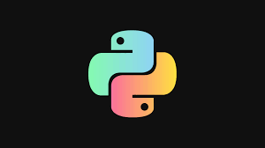
Stone paper scissor game using python
Subject:Project Based Learning(PBL)
Presented By:
Shubham Nandkumar Bankar
Roll No:104 Div:A
Under Guidance of:
Prof.U.K.Shirke

Slide 2
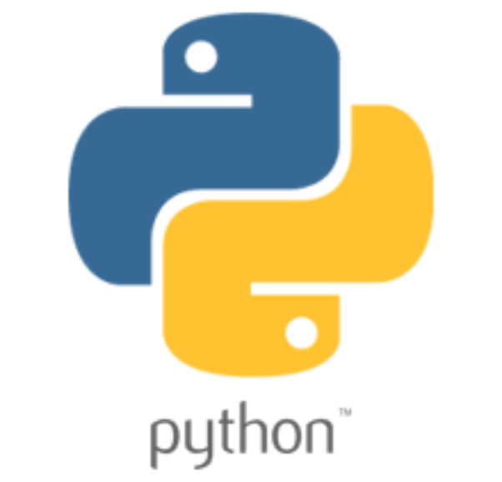
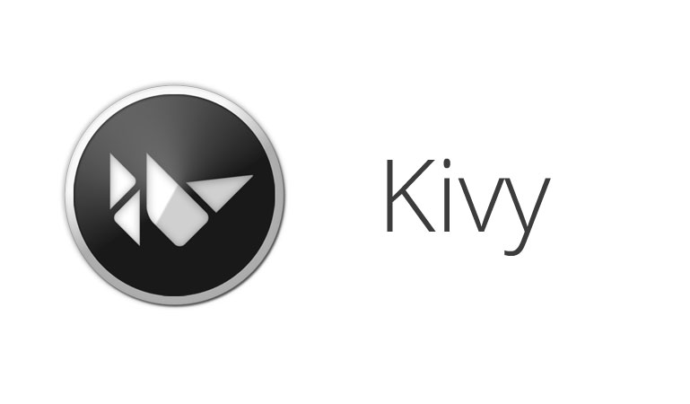
Description:
I have created an android application using
1)Python Programming Language.
2)Kivy Framework.
3)Buildozer Tool.

Slide 3
python
Python is an interpreted, object-oriented, high-level programming language.
Free and Open-Source.
Python language is also a portable language.
Vast Libraries Support

Slide 4

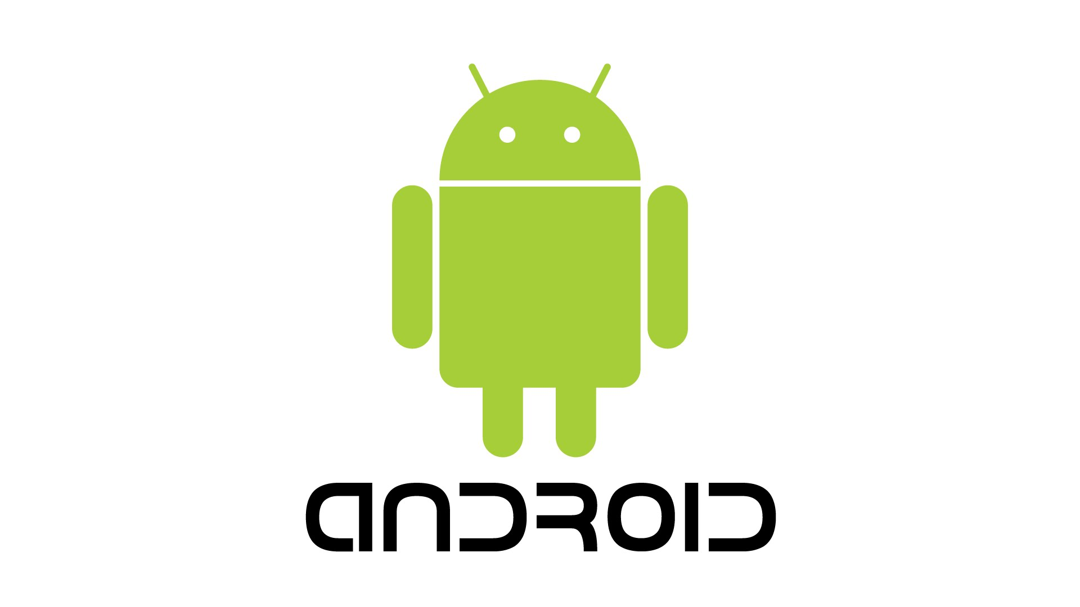
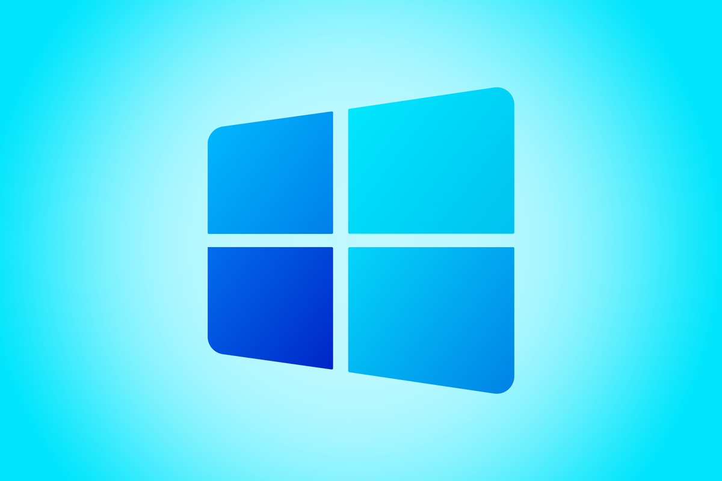

Kivy Framework
Kivy is a free and open source Python framework for developing mobile apps and other multitouch application software with a natural user interface.
It has cross platform support: As It can smoothly work with various platforms such as Windows, Android, Linux, iOs, macOS, and Raspberry Pi.

Slide 5
Buildozer tool
It automates the entire build process, download the prerequisites like python-for-android, Android SDK, NDK, etc. Buildozer manage a file named buildozer.
It doesn’t work on windows . We need to use Linux distro to use it.
It is a CLI(command line interface)tool.

Slide 6
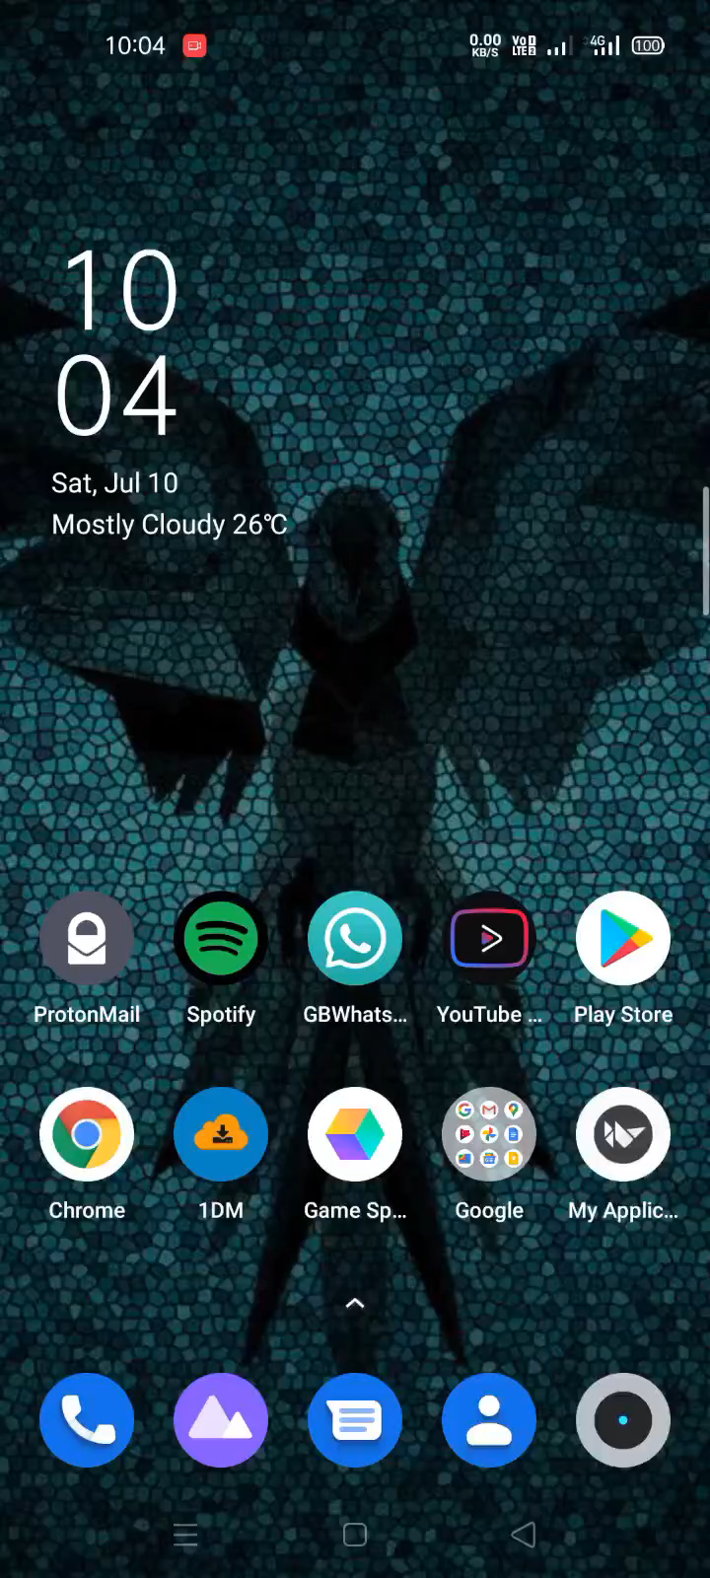
Running the Program on android

Slide 7
